Slide 1
What exactly is DevOps?
‘DevOps.’ It is nothing but the practice or methodology of making ‘Developers’ and the ‘Operations’ team work together.
(OR)
The word "DevOps" is a combination of the words "development" and "operation". This wordplay already serves to give us a hint of the basic nature of the idea behind DevOps.
(OR)
DevOps describes a culture and set of processes that bring development and operations teams together to complete software development
It allows organizations to create and improve products at a faster pace than they can with traditional software development approaches.

Slide 2
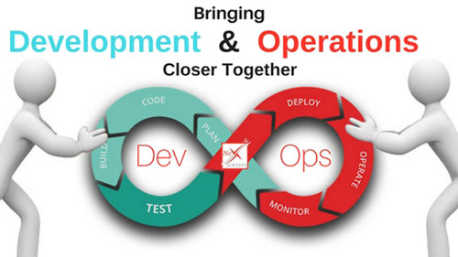

Slide 3
History of DevOps
Before DevOps came into the limelight, our traditional ol’ IT had two separate teams in an organization – the Development team and the Operations team.
The development team worked on the software, developing it and making sure that the code worked perfectly. After hours of hard work and a lot of trial and error, the team releases a code which has to be executed by the Operations team which is responsible for the release and operation of the code.
The operations team will be checking the application and its performance and reporting back any bugs, if present.
The concept of DevOps emerged out of a discussion between Andrew Clay and Patrick Debois in 2008. They were concerned about the drawbacks of Agile and wanted to come up with something better.
Agile refers to the continuous iterative approach, which focuses on collaboration, customer feedback, small, and rapid releases.

Slide 4

OPS Team

Slide 5
Simple example
For instance, let us say, the development team developed a code using an i7 processor, 8GB RAM, OS as Ubuntu, and php 5.6 scripting language, where as the Operations team ran the same code using i5 processor, 16GB RAM, OS as Centos and php 7.0 programming language.
When the operations team ran the same code, it wouldn’t work.
The reason for this could be the difference in the system environment or any missing software library.
The operations team flagged this code as faulty, even though the problem could exist in their own system. This resulted in a lot of back and forth between the Developers and the Operations team.
To bridge this gap, Development(‘Dev’) team and Operations (‘Ops’) team collaborated giving rise to DevOps.
For example, to solve the above problem, the Development team encapsulated their code in a container which is a lightweight software environment.
This software environment had all the required software encapsulated in it, which the code or the application will require to run as expected.
When the developers were done with their work, they would simply pass on this container along with the code to the operations team. The Ops will run this container, along with the code, and it worked as expected!

Slide 6
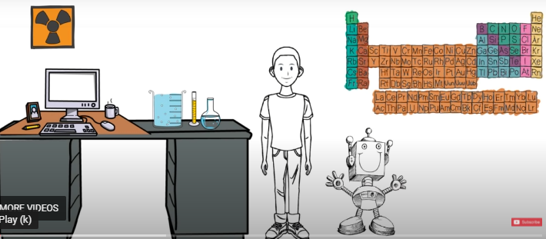
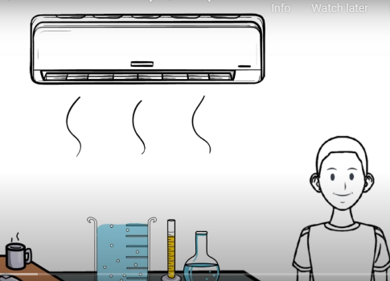

DevOps General Example

Slide 7
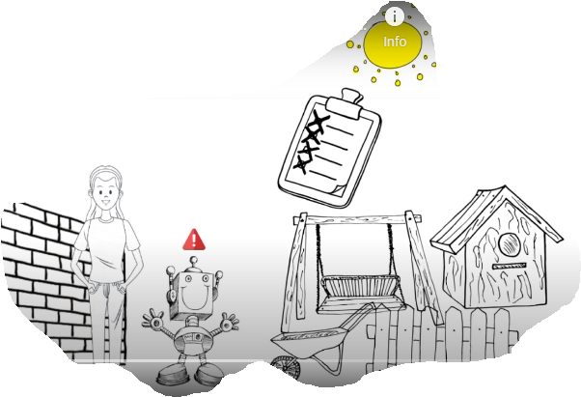


Slide 8


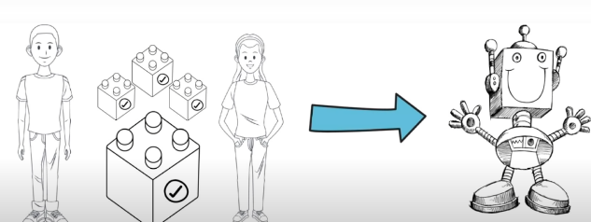

Slide 9
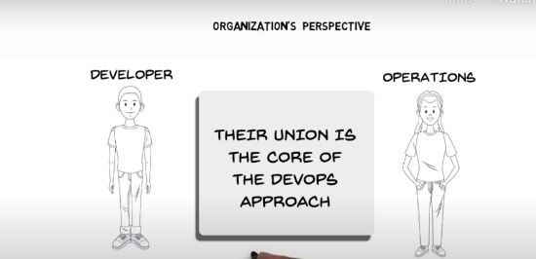
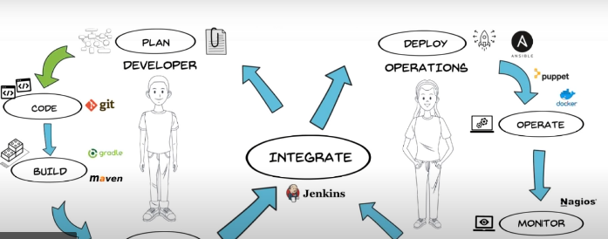
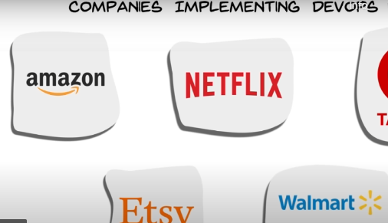

Slide 10
Development Group:
The people who are involving
1) planning
2) coding
3) build
4) Testing are considered as Development Group.
Eg:
Business Analyst(BA) : A Business Analyst is a person who helps businesses to analyze their processes, products, services, and systems to improve current processes and make profitable decisions through insights and data analysis.
System Analyst(SA) :Systems analysts are problem solvers at heart. Their primary responsibility is to act as a link between an organization's IT and non-IT stakeholders, designing or implementing the correct computer software, hardware, and cloud services to solve business problems.
Design Architect(DA)
Design Architects create plans and gather design requirements for new structures. They may also be called upon to design alterations or repairs to existing buildings and structures. Their role is to focus on the style and look of the project while adhering to all building requirements and codes.

Slide 11
Build Engineer :They are responsible for overseeing and ensuring timely software releases for organizations and may manage the software implementation process from development to execution.
Test Engineers/QA : Software test engineers identify and fix technical issues across various aspects of a product, such as functionality, durability, safety, and speed, to ensure that the quality of the final product matches the quality guidelines and expectations set by the company.
Developers/coders : Researching, designing, implementing, and managing software programs.

Slide 12
2) Operations Group:
The people who are involving
1) Release
2) Deploy
3) Operate
4) Monitor are considered as Operations Group.
Eg:
Release Engineers
Configuration Engineer
System Admin
Database Admin
Network Admin etc

Slide 13
Operations Group responsibilities.. (Continued..)
Infrastructure provisioning covering both hardware and software - quickly and on-demand in order to support the development, testing, deployment, and maintenance of products or services
automated and secure environments for change management
Efficient monitoring and control of the systems
Disaster recovery and outage management
Compliance and security threat management There could be more functions that the Ops team does depend upon the size, complexity, and context of an enterprise but the typical ones should be the above.
Infrastructure/Operating System and Hardware
Desktop Packaging
Database Vendor Products
Onboarding Support Function

Slide 14
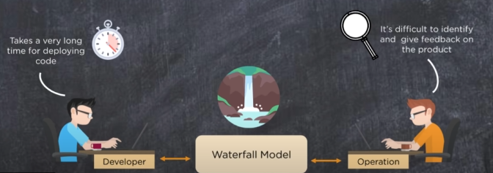
Why DevOps?
Before understanding the concepts and methodology of DevOps, we need to understand why do we even need DevOps? Why DevOps? Why not other methods?

Slide 15
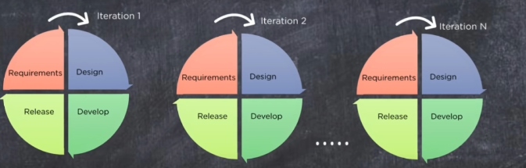

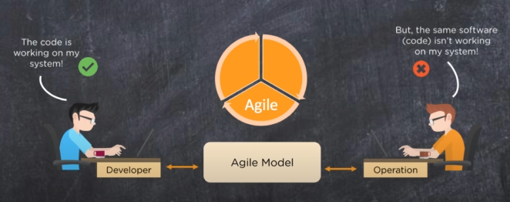
Agile:

Slide 16
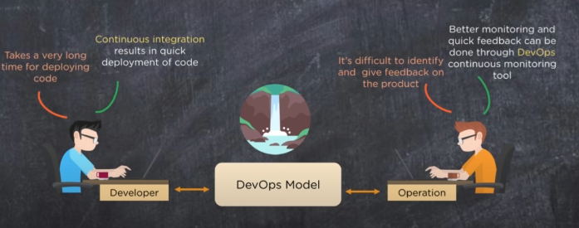

Slide 17
